Slide 1
Visualizing Hidden Stories of UD Sculptures using Deep Learning
Anjana Gunathilake (gunathilakea1@udayton.edu | 1013017520)
Vijay Ganaraju(ganarajuv1@udayton.edu | 101679989)

Slide 2
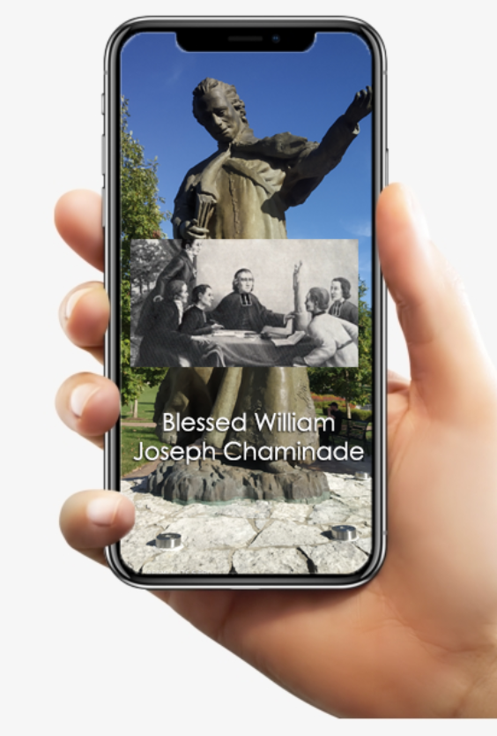
PURPOSE OF THE PROJECT
The purpose of this project is to make a mobile application that can detect the statue and play an embedded video in seconds on the screen with no hassle, by just pointing the camera at it.
This app makes it easy to learn the history behind the statues without any extra effort.

Slide 3
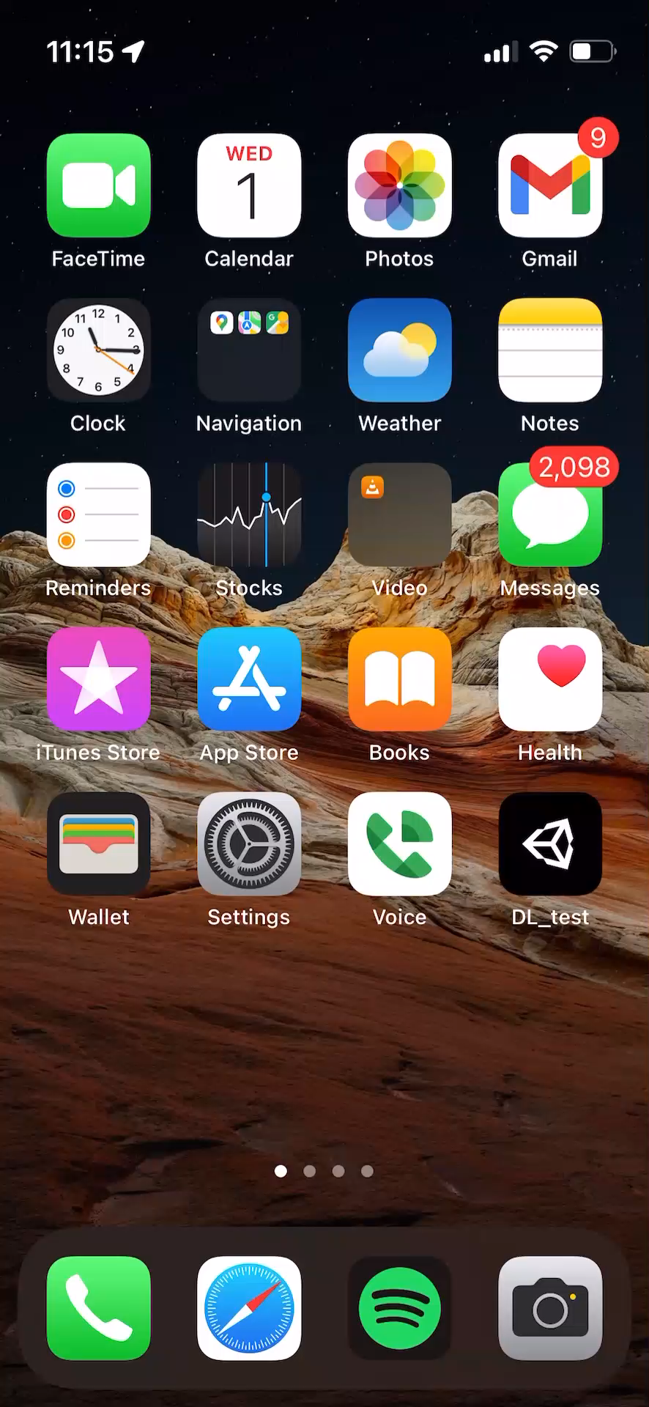
PROJECT
OUTPUT

Slide 4
PROJECT DESCRIPTION
First, we created a Deep Learning(DL) image classification model and converted it to Open Neural Network Exchange(ONNX) file format. Then we simulated and tested the model in Unity with the Barracuda inference engine. Finally, we deployed our model to an iOS device.
Our input is an image dataset that comprises 6820 images belonging to 24 classes.
We used the TensorFlow(TF) platform for creating our Deep Learning model. We focused mainly on lightweight models. After overcoming various pitfalls and performance issues, we have decided to train our dataset with the EfficientNet-Lite4 architecture.
The training accuracy and validation accuracy of our model after training our dataset for 20 epochs were 95% and 94% respectively. The accuracy for the test dataset was 88%.

Slide 5
Out data set comprises images from 24 sculptures all around the University of Dayton main Campus.
Each group involved in the project took the responsibility to provide at least 100 images of the selected sculpture.
We received our initial dataset from our Teaching Assistant(TA).
The raw images were varying in size and some of the images were not in the same format as others. So, we did necessary preprocessing on the raw images before we feed them to the deep learning model.
We reduced the size of the images, turned all the images in the same (jpg) image format, renamed them according to the class they belong to, and added new images manually, to improve the quality of the dataset.
SOURCE OF DATA

Slide 6
We split our dataset into training and validation sets in 70% train, 30% validation.
We collected a separate dataset for testing the model that comprises 480 images, 20 images from each sculpture.

Slide 7
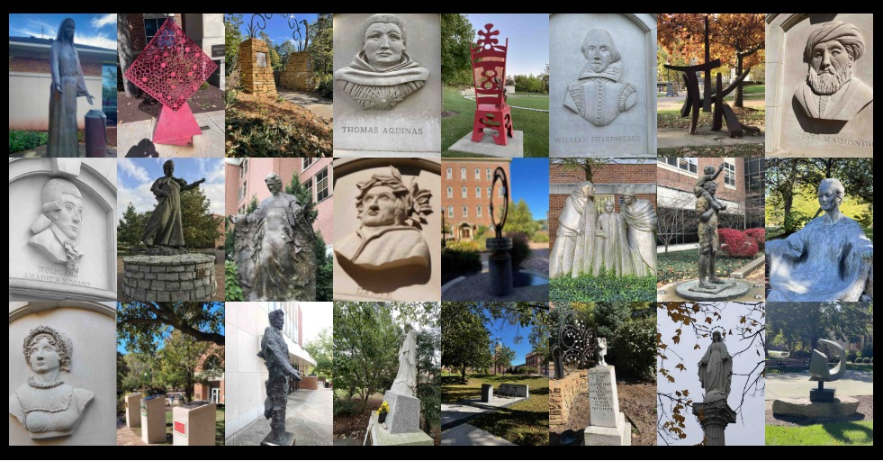
IMAGES

Slide 8
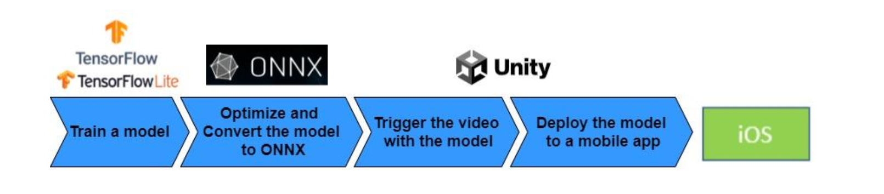
PROJECT IMPLEMENTATION

Slide 9
We used the TensorFlow(TF) platform for creating our Deep Learning model. We trained our dataset on Colab notebooks as well as jupyter notebooks. Colab notebooks include GPUs and it helped us to train our dataset much easier and faster than our own machines.
Covert to ONNX Format. ONNX(Open Neural Network Exchange) is an intermediate machine learning framework used to convert between different machine learning frameworks.
Loaded model and other necessary files to Unity Barracuda. Unity Barracuda is a lightweight and cross-platform Neural Net inference library for Unity. Barracuda can run Neural Nets both on GPU and CPU.
Create inference engine. execute model. fetch results.
Deploy model to the iPhone using Xcode IDE.
PROJECT IMPLEMENTATION

Slide 10
We tried several pretrained models for selecting the best model.
Steps
We trained each model on our training dataset
Evaluated each trained model’s performance on the validation dataset
Chose the model with the best validation dataset performance
Evaluated the chosen model on the test dataset
MODEL TRAINING

Slide 11
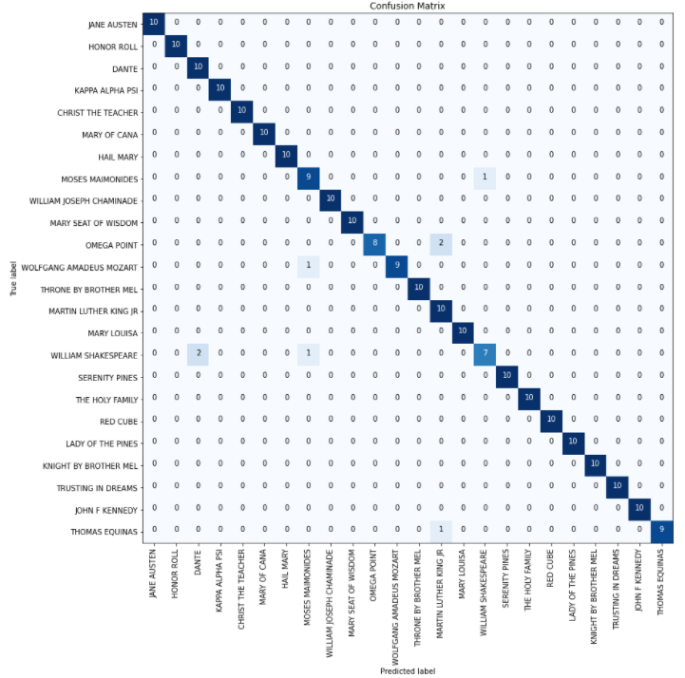
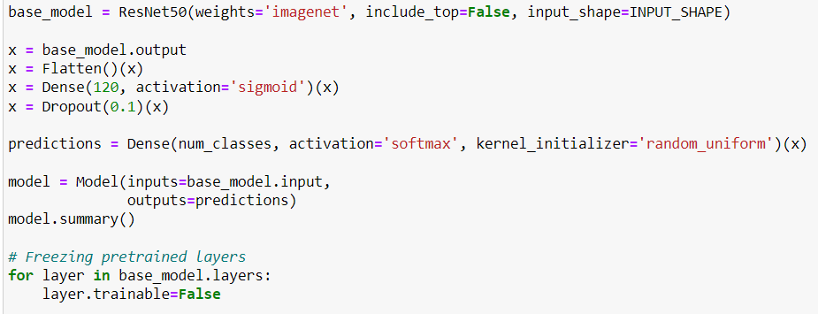
PITFALLS
ResNet50 with Transfer Learning
Couldn’t covert to tflite format.
Converted to ONNX format with opset version 11. But the file size was 150MB.
Unity was not supporting.

Slide 12
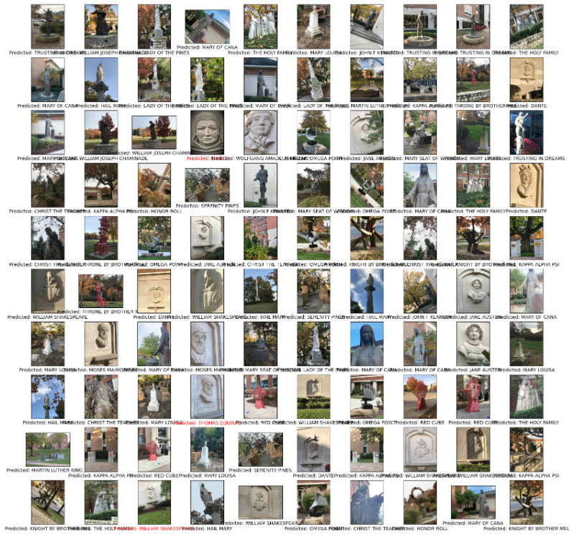
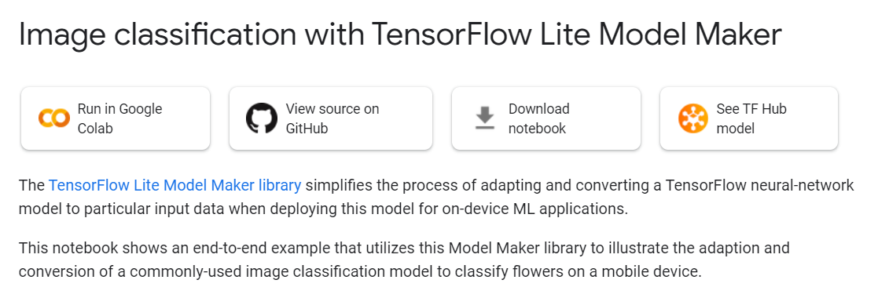
EfficientNet-Lite4
Couldn’t convert the generated tflite model to ONNX format with the opset 11.
It was asking opset 13 for converting and Unity does not support ONNX models which converted with opset 13.

Slide 13
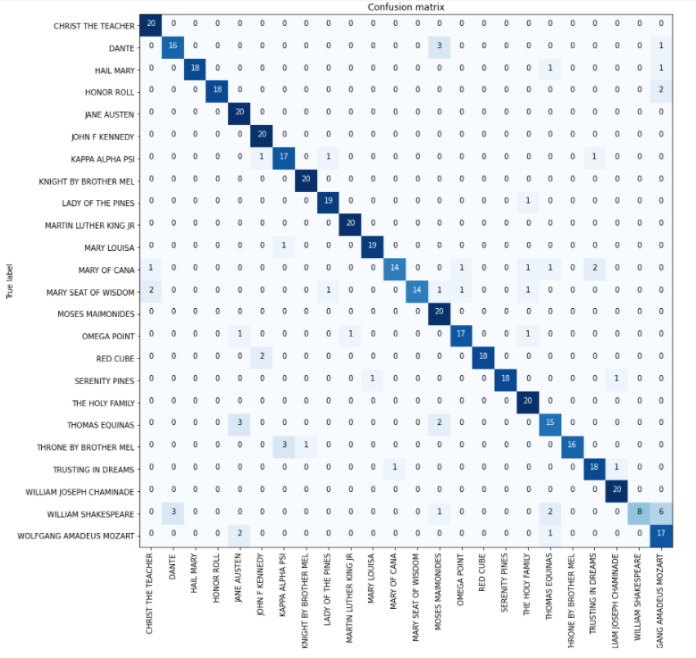
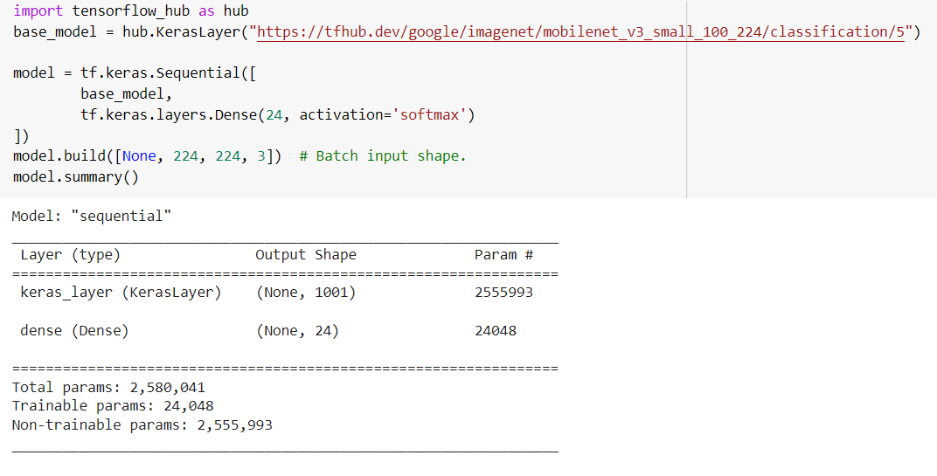
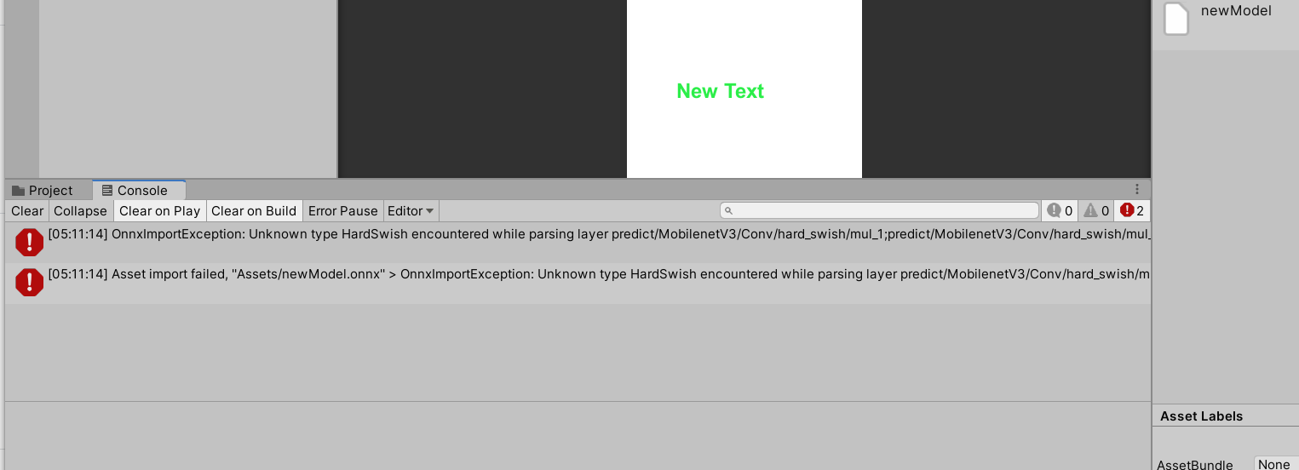
MobileNet-LiteV3 – Tensorflow hub
Unity was not compatible with the converted ONNX model.

Slide 14
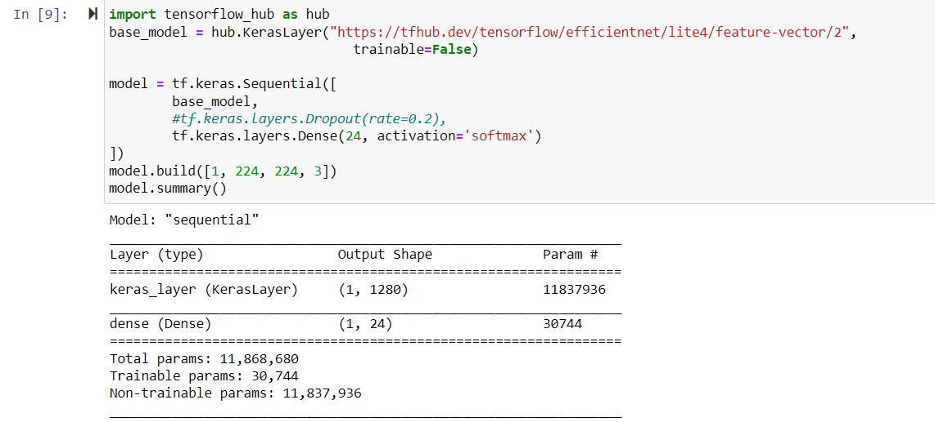
Selected Model - EfficientNet-Lite4 – Tensorflow hub

Slide 15
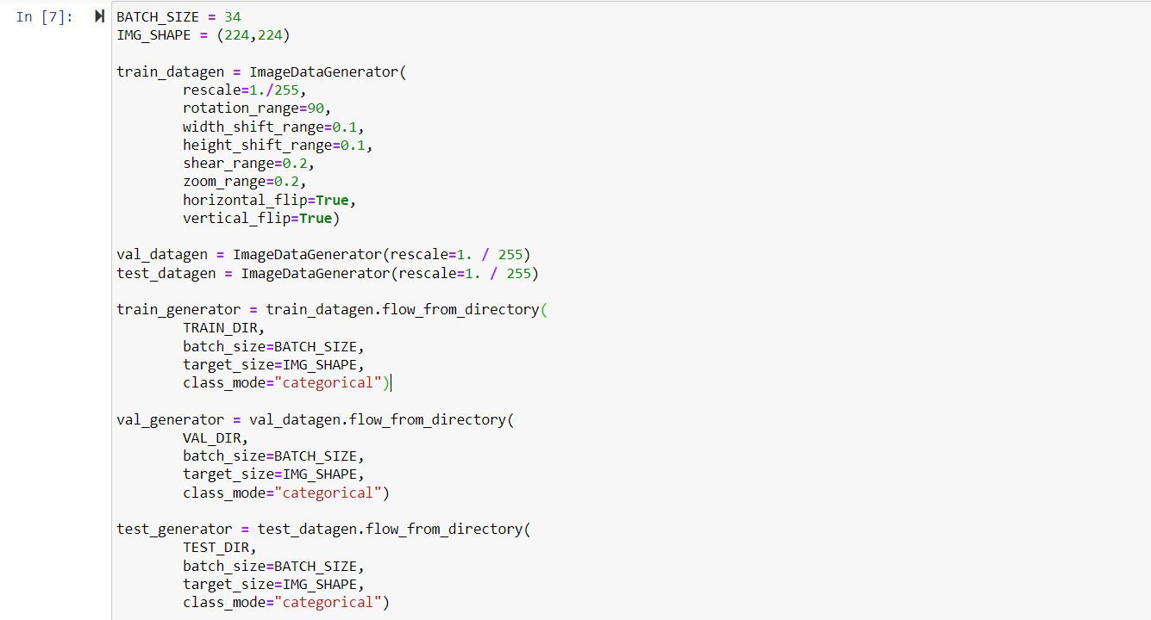
Image Data generator

Slide 16
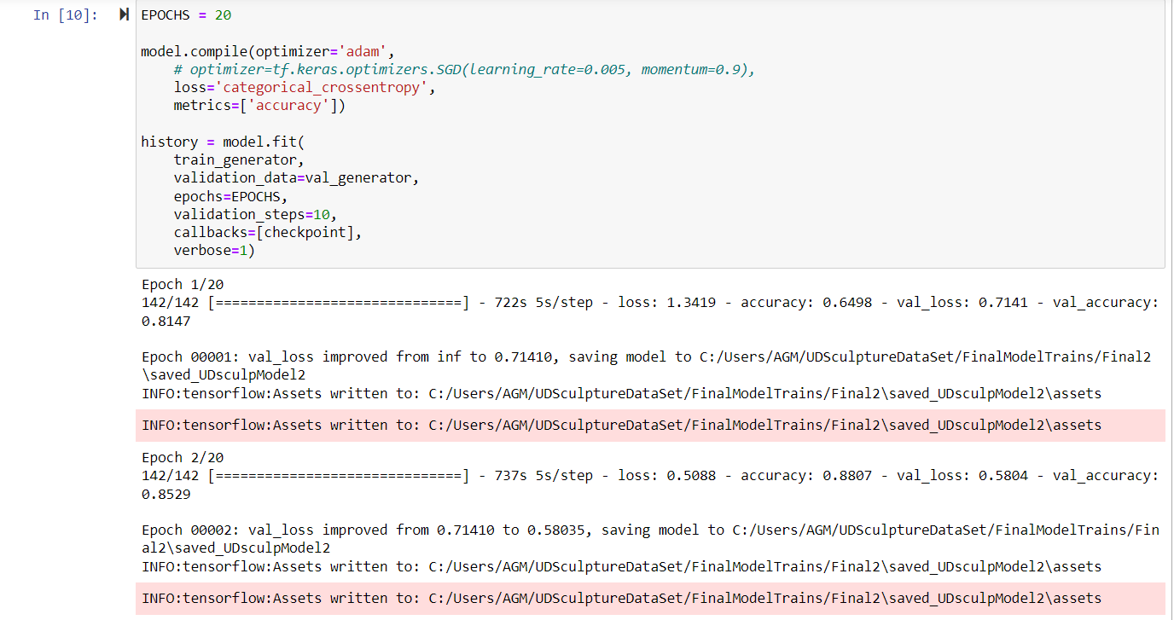
Compile and Fit

Slide 17
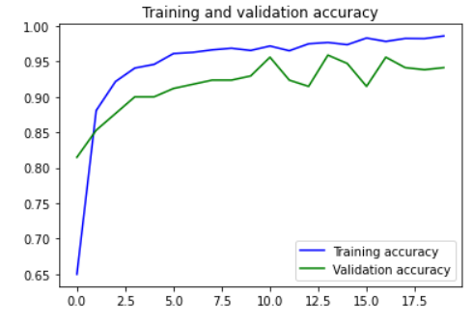
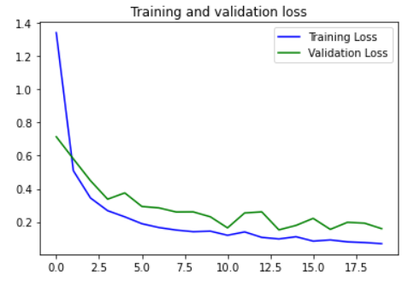
Train and validation loss and accuracy for 20 epochs

Slide 18
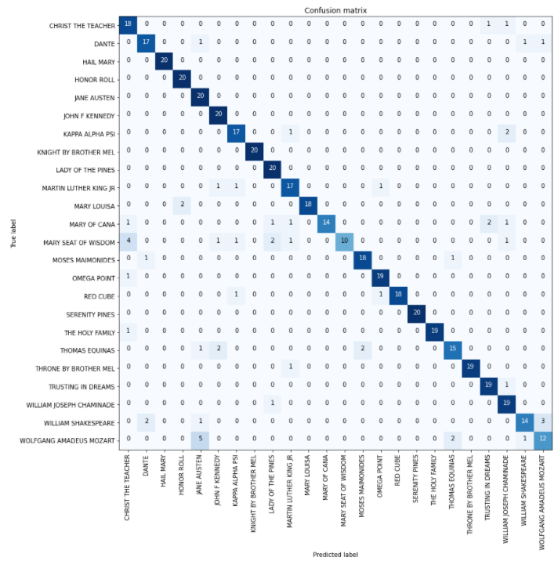
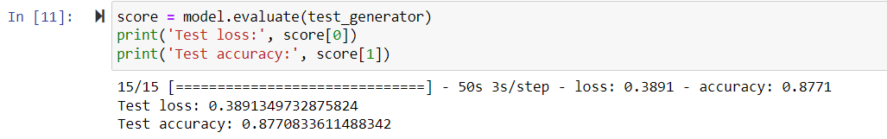
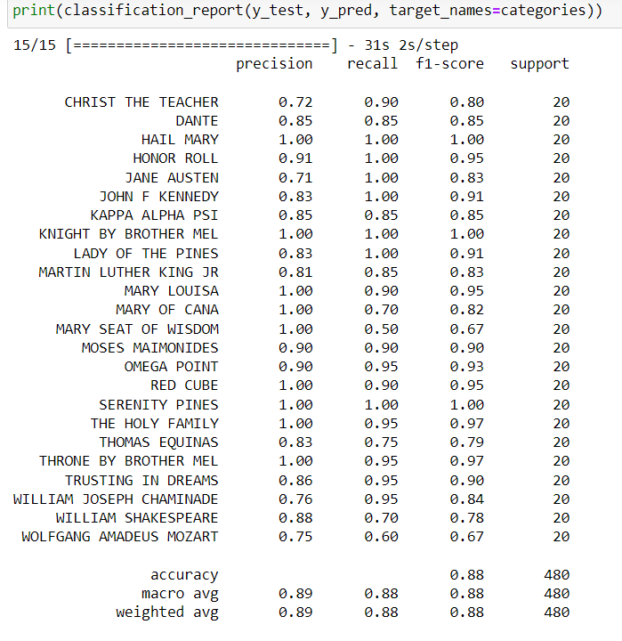
Test Results

Slide 19
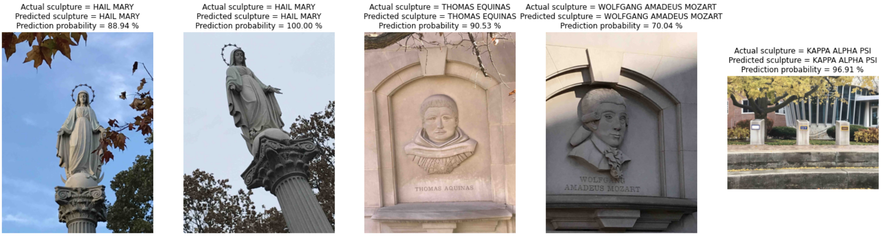
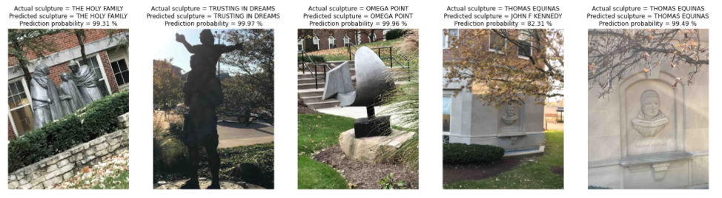
Predictions

Slide 20
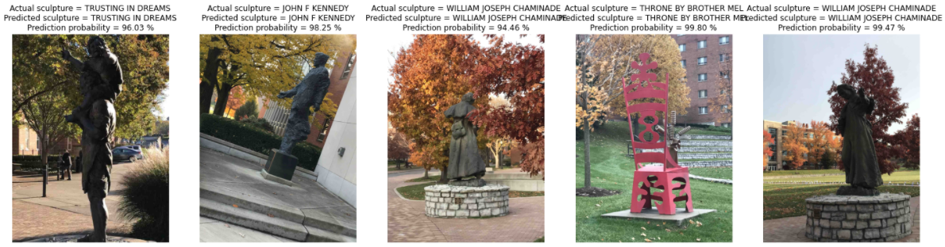
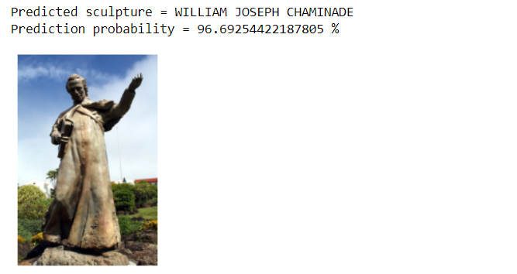
Predictions

Slide 21
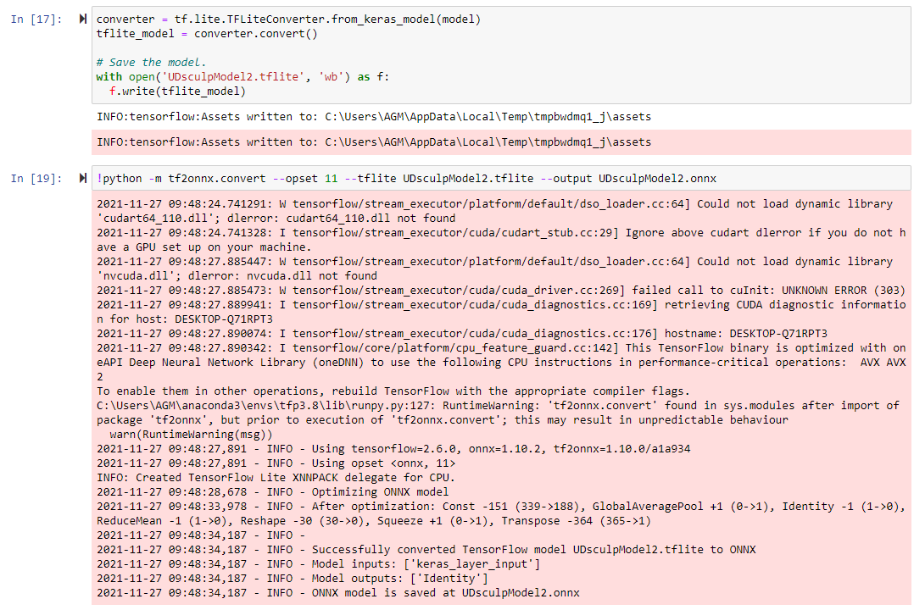
Convert to ONNX Format

Slide 22
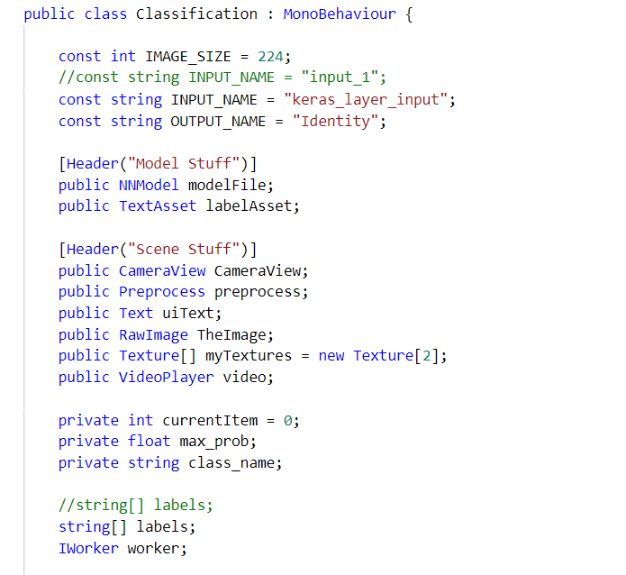
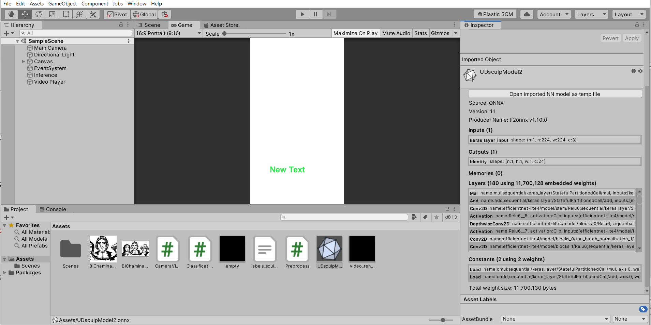
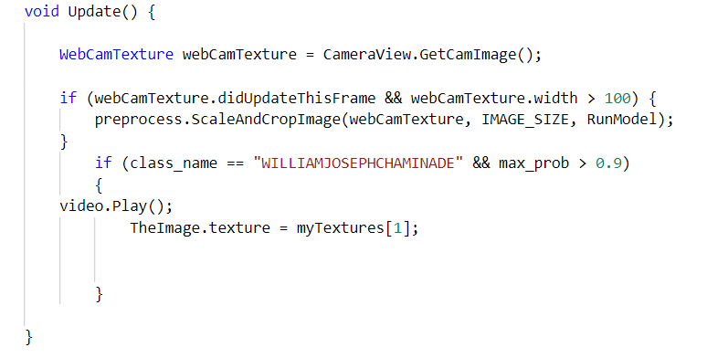
Simulation in Unity

Slide 23
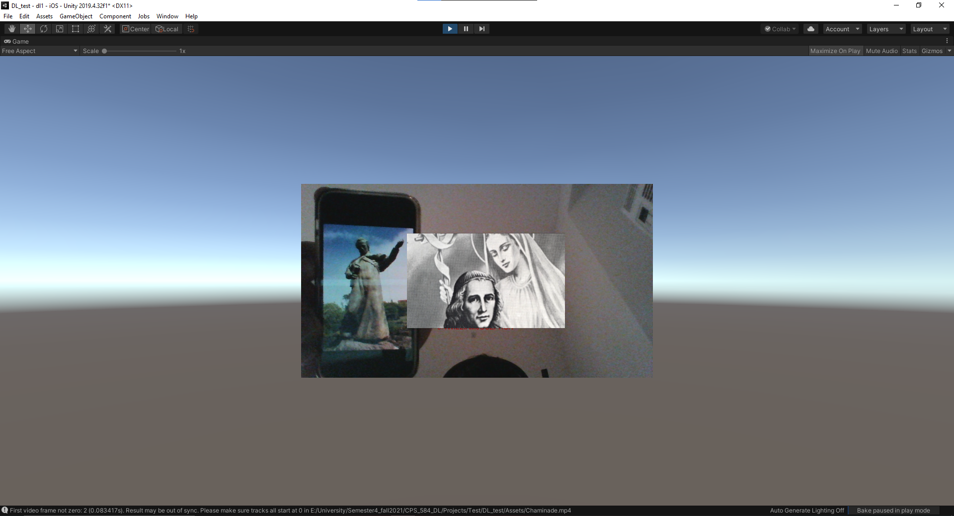
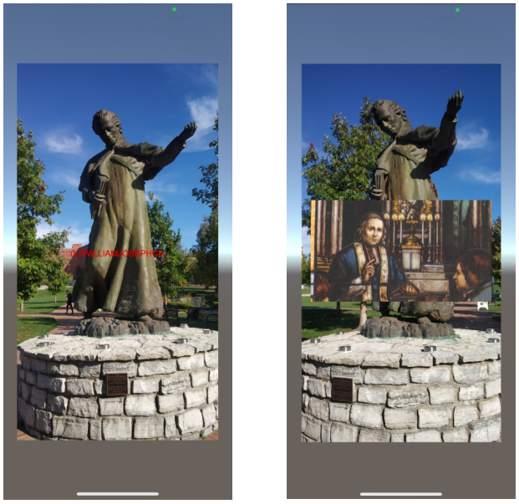
Testing Results

Slide 24
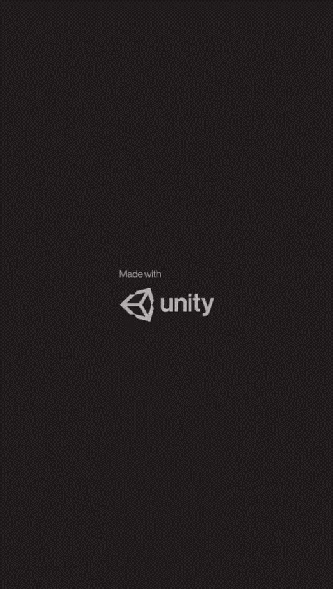
Blessed William Joseph Chaminade

Slide 25
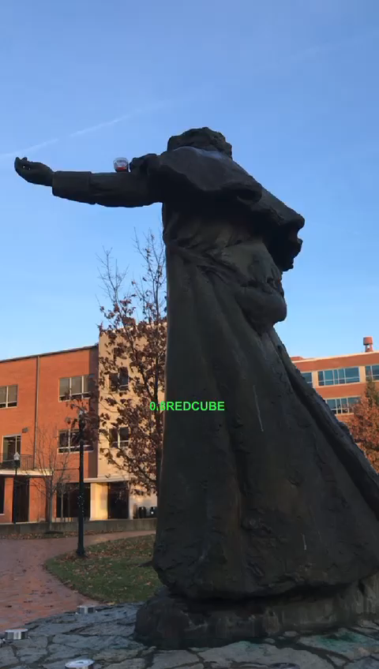
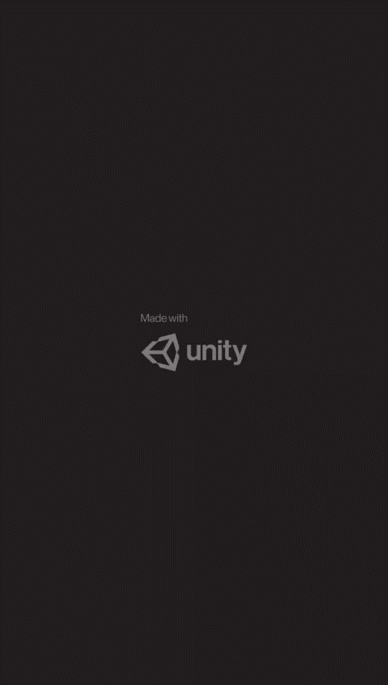
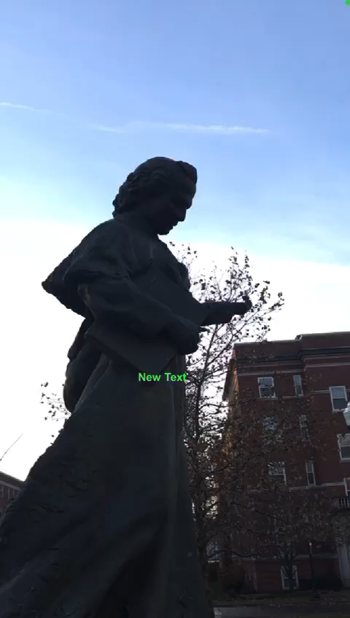
Blessed William Joseph Chaminade

Slide 26
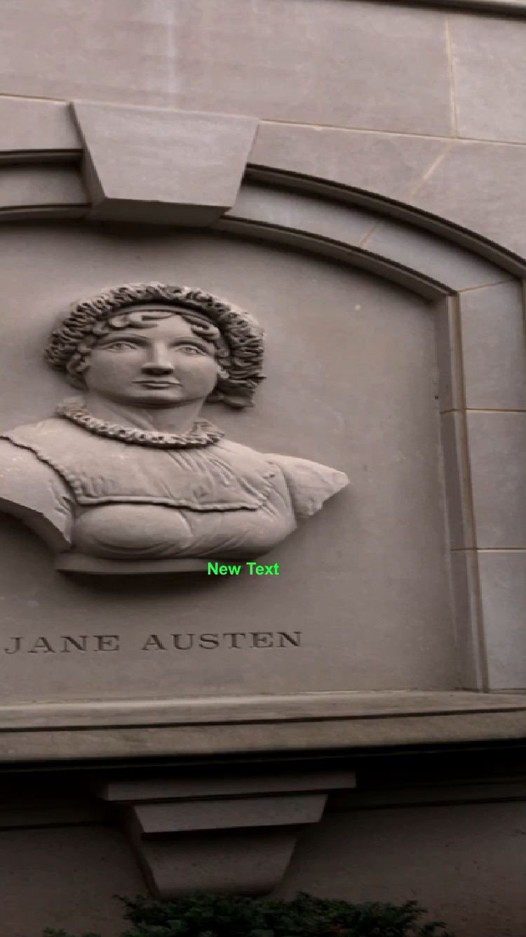
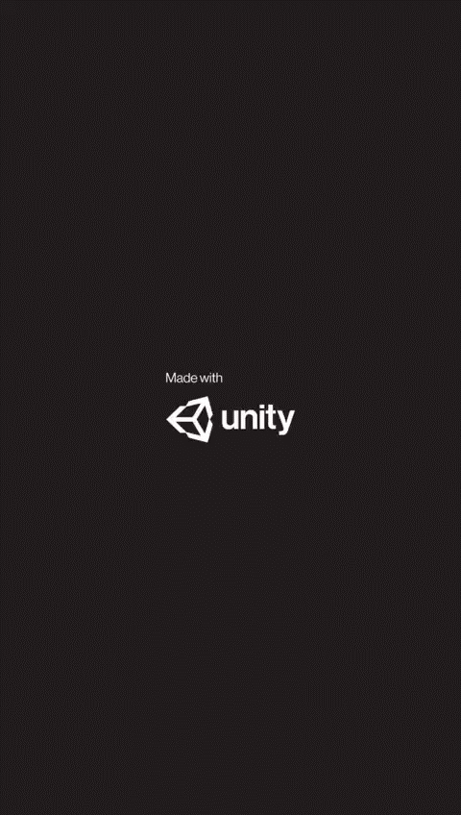
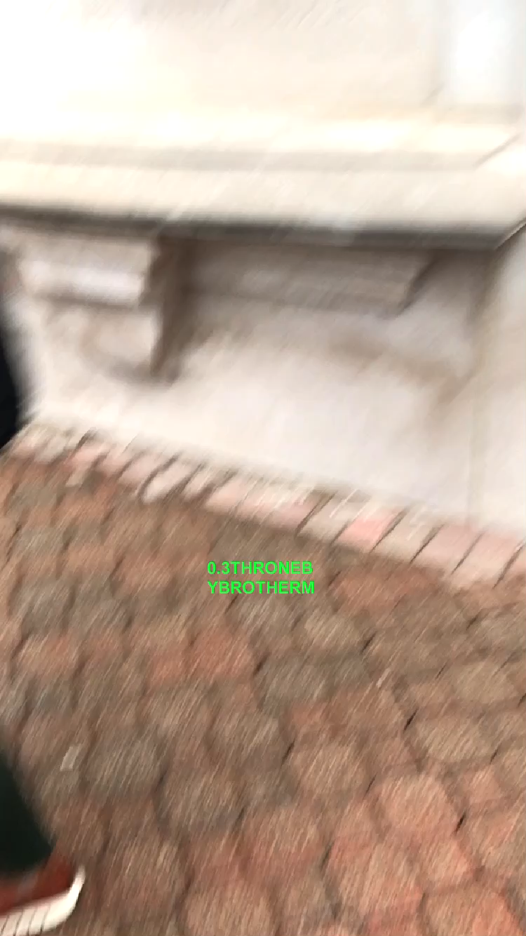
Other Statues

Slide 27
Conclusion
Our model is working for almost all the statues with high accuracy and the scope of the application is way beyond its current utility.
We have designed an application that provides the user with maximum information in a minimum time and with minimum inconveniences. It can detect the statue and show its history within seconds. It has also reduced the number of steps to get to know the statue as the attention span of an average person has declined significantly over the time which is the reason platforms that host short forms of content such as Tiktok and Instagram reels are a major hit recently.

